Slide 1
Introduction to Computer Science
and Java

Slide 2
"Computer science is as much about computers as astronomy is about telescopes."
- Edsgar Dijkstra

Slide 3
Computer science is…
Determining what problems can be solved with a computer
Developing step-by-step instructions (algorithms) for solving these problems
Evaluating the efficiency of different algorithms
Expressing and implementing algorithms by using programming languages
Designing and building software that uses algorithms to solve real-world problems
… And many other things!

Slide 4
Computer science is NOT…
Designing computer hardware components
Building or repairing computers
Managing computer networks
Gaining expertise in using specific software applications (Windows, Linux, Office, Photoshop, etc.)
But…
Even though computer scientists aren't involved with designing computers, we should still have a basic understanding of how they work

Slide 5
How a computer works
Computers consist of hardware and software
Hardware refers to the physical components that make up the computer. Major hardware components:
  Processor (also called central processing unit or CPU)
  Memory (also called main memory, primary memory, random access memory, RAM)
  Storage (also called secondary memory)
Lots of other hardware devices too (input/output devices, video cards, network cards…), but the above are the “Big Three”
Software (computer programs) refers to the instructions that tell the hardware how to carry out specific tasks

Slide 6
How a computer works
Installed programs and data on your computer are kept permanently on the hard drive (storage).
  Programs and data are stored using 0’s and 1’s (binary digits or “bits”)
When you run a program:
  The program and any necessary data are loaded from storage to main memory
  The processor executes (runs) the program by repeatedly fetching program instructions from memory and executing them (fetch-and-execute cycle)
Storage
Program is loaded into memory
Results from processor are placed into storage and/or memory
Memory
Processor reads program instructions from memory
Processor
Processor executes program instructions

Slide 7
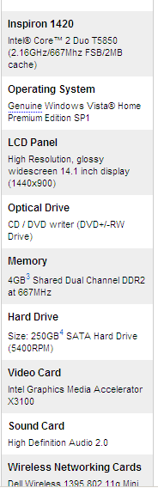
How a computer works
Processor
Speed measured in gigahertz (GHz) – billions of cycles per second
Main memory
Capacity measured in gigabytes (GB) – how much data the RAM can hold
High-speed, temporary storage of programs and data
1 byte = 8 bits
Secondary memory
Capacity measured in gigabytes (GB)
Slower, permanent storage of programs and data

Slide 8
Creating software
Software is the set of instructions that tell a computer’s hardware (mainly the CPU) how to perform certain tasks
At its most basic level, software just consists of binary instructions (sequences of 0’s and 1’s). This is called machine language.
The most direct way of telling a CPU what to do is to give it instructions in its binary machine language!

Slide 9
Creating software
A computer programmer (or software engineer) is a person who develops new software
To avoid having to write instructions in machine language, programmers usually write software in a high-level programming language, which is translated to machine language before it’s run
  Much easier and more intuitive to use a high-level language than machine language
  Instructions written in a programming language are known as source code (sometimes just “source” or “code”)
  Commonly used languages today: C, C++, C#, Java, Visual Basic, Perl, Python, PHP, many others
  Older languages: Fortran, COBOL, BASIC

Slide 10
Creating software
The basic software development process:
  Programmer creates clear definition of problem
  An algorithm is developed that provides a step-by-step plan to solve the problem
  Programmer uses a programming language to express the algorithm
  Completed program undergoes testing to debug (find and fix errors)
  Final software is released and maintained

Slide 11
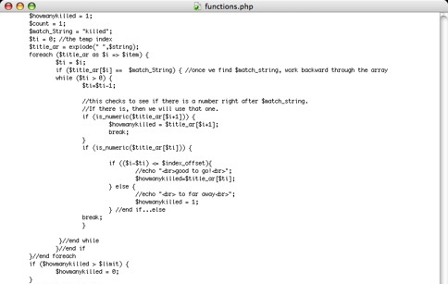
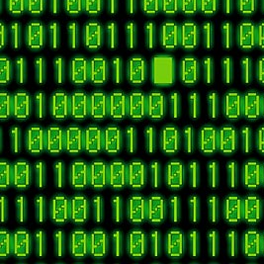



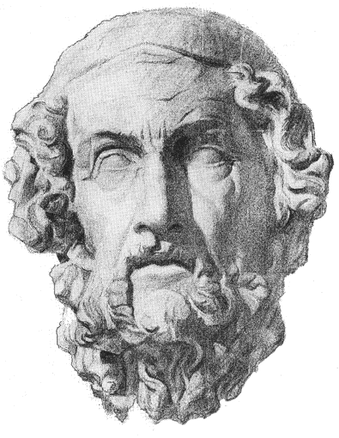
Translating computer languages
compiler /
interpreter
programmer
source code
(in high-level programming language)
machine language
translator
author
book (in foreign language)
book (in
English)

Slide 12
Translating computer languages
Two ways of translation:
  In compilation, source code is translated by a program called a compiler into machine language all at once, prior to runtime
  In interpretation, a program called an interpreter translates the source code “line by line” as the program is being run
Analogy: Translating a book (compilation) vs. translating a speech in real-time (interpretation)
  You don’t need a compiler to run a compiled program, just as you don’t need a translator to read a book that’s already been translated
  However, you DO need an interpreter to run an interpreted program (it needs to be translated as it’s running)

Slide 13
The Java language
Java involves both compilation and interpretation
  A programmer writes Java source code, which is compiled “halfway” into an intermediate state called bytecode
  Bytecode is not machine language – a CPU can’t directly understand bytecode!
  Bytecode must be translated into machine language by an interpreter called the Java virtual machine (JVM)
Java virtual machine
(JVM)
Java
source code
Java compiler
Bytecode
Machine
language

Slide 14
The Java language
Why do things this way?
  Portability (platform independence)
    “Write and compile once, run anywhere”
    Compiled Java bytecode can be run (interpreted) on any platform that has a Java virtual machine
    By contrast: a program compiled using a traditional compiler can run only on the platform it was compiled for

Slide 15
The Java language
You might be wondering:
Well, Java still requires a platform-specific JVM to work on a particular platform. What’s the advantage over compiling the source straight into machine code using a platform-specific compiler?
  It’s easier to write a bytecode-to-machine code translator (a JVM) than a source code-to-machine code translator (a traditional compiler)

Slide 16
Getting started with Java
Software needed for writing Java programs
  Java itself – see the posted software setup guide on eCourseware for installation instructions
  A source code editor for writing your code
    Source code editors are programs you use for writing source code – sort of like Microsoft Word for programmers
    Have features like syntax highlighting – automatically formats certain parts of your code to make it easier to read

Slide 17
Getting started with Java
Sometimes source code editors are part of larger programs called integrated development environments (IDEs)
IDEs include a number of features designed to help programmers work efficiently:
  Source code editor
  Compilers and interpreters
  Debugger to help find and fix coding errors
  Tools to help create graphical user interfaces (GUIs)
Examples of professional IDEs:
  NetBeans (http://www.netbeans.org/)
  Eclipse (http://www.eclipse.org/)
  Microsoft Visual Studio
For this class we’ll be using a teaching-oriented Java IDE called BlueJ (http://www.bluej.org/)

Slide 18
BlueJ != Java
!= means “not equal to”
BlueJ is an IDE, not a programming language
BlueJ is just a program that makes it easier for you to write, compile, and run your own Java programs
There are plenty of Java programmers out there who never use BlueJ!

Slide 19
Do this by next class!
This homework won’t count for a grade
  But you should do it anyway because it’ll be essential to doing the real assignments!
Download and install Java and BlueJ on your own computer. See the instructions posted on eCourseware!

